Slide 1
Lecture 9
REVIEW of LEVELS OF PROTEIN STRUCTURE
THERMODYNAMIC STABILITY OF PROTEINS

Slide 2
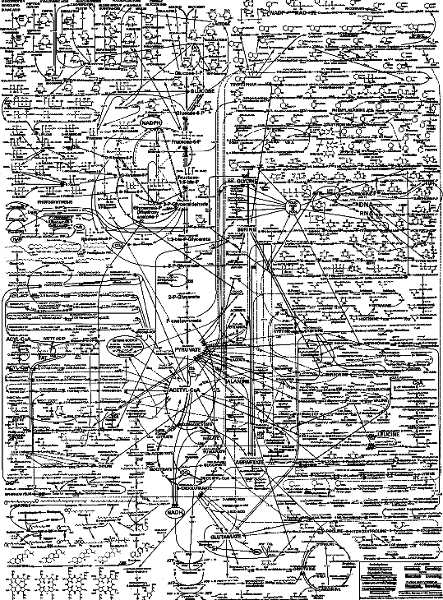
What are these binding/interaction domains all about?!
Interconnections!
~ 5000 reactions in a cell must be coordinated with each other; turned on/off at exactly the right times
Binding/interaction domains (scaffold proteins) are one main way to connect these reactions: xxto each other; xxto "signals”; xxto DNA & RNA

Slide 3
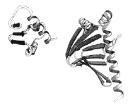



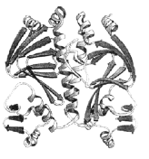
Review of the levels of protein structure:
ARG-
LYS-
PRO-
-ALA-
GLN-
PHE-
GLY-
CYS-
HIS-
SER-
LEU-
Primary structure, I
The AA sequence
Secondary structure, II
α-helix, β-sheet, turns, "loops", collagen call these "elements of structure", no regard for sidechain details
Folds
The stable folding units; also no regard for sidechain details
Tertiary structure, III Entire path of single polypeptide chain. (All the folds that specify the 3D structure: Might be one or several or many folds). Also, sidechain structure is included!
Quaternary structure, IV
(Dimer is shown)
Association of more than one polypeptide chain

Slide 4
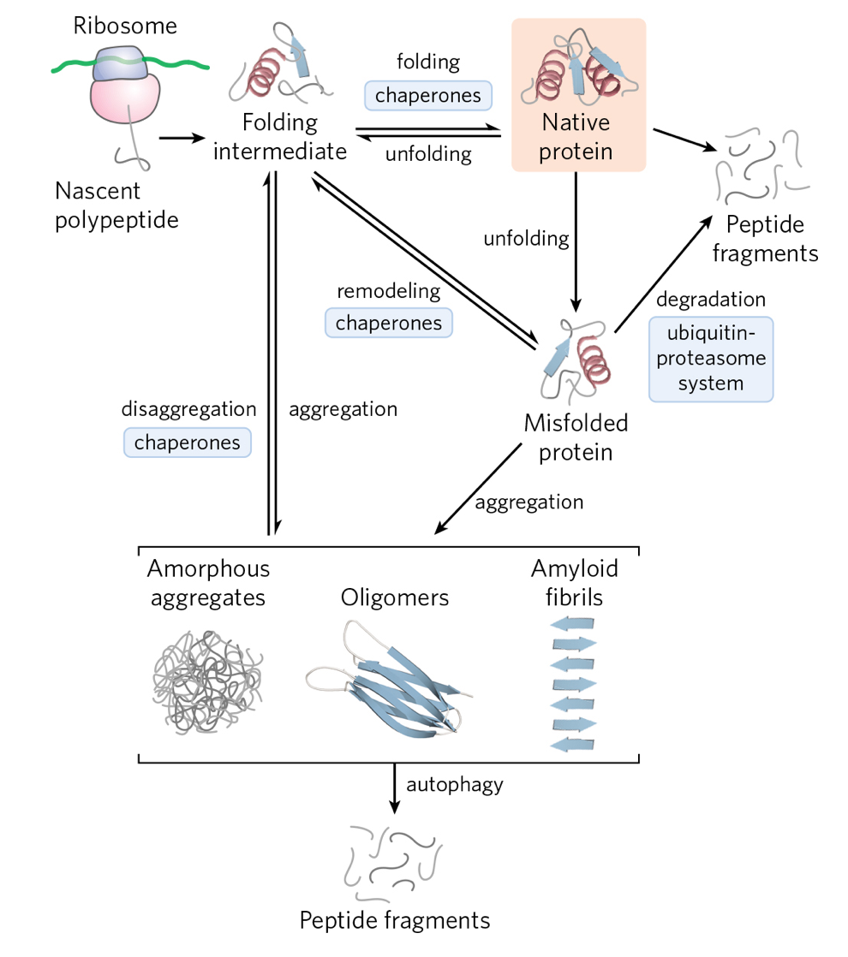
Thermodynamics of Protein Stability
ΔG
Very
flexible
In equilibrium!
Unfolded
protein
Stable means predominantly folded (“Native”) in its native environment

Slide 5
Setting the Context
Why might we care about protein stability?

Slide 6
Chaperones help to prevent protein misfolding
KEY POINTS:
proteins are dynamic!
exchange between folded & unfolded states at equilibrium
chaperone proteins help avoid accumulation of misfolded or aggregated states
disease can happen!

Slide 7
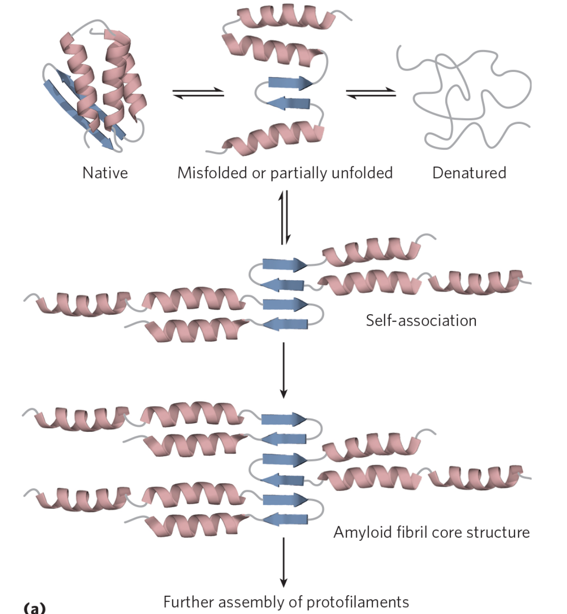
Disease-causing amyloid fibril formation
Rich in β-sheet
structure
Fibril axis

Slide 8
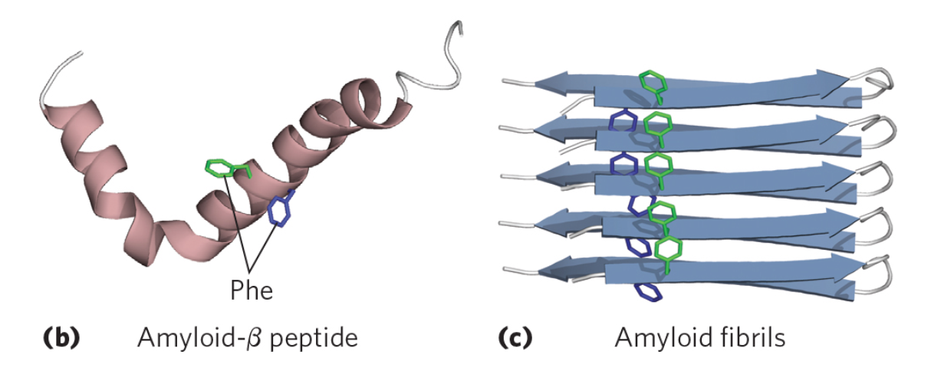
Alzheimer’s Disease
Fibril axis

Slide 9
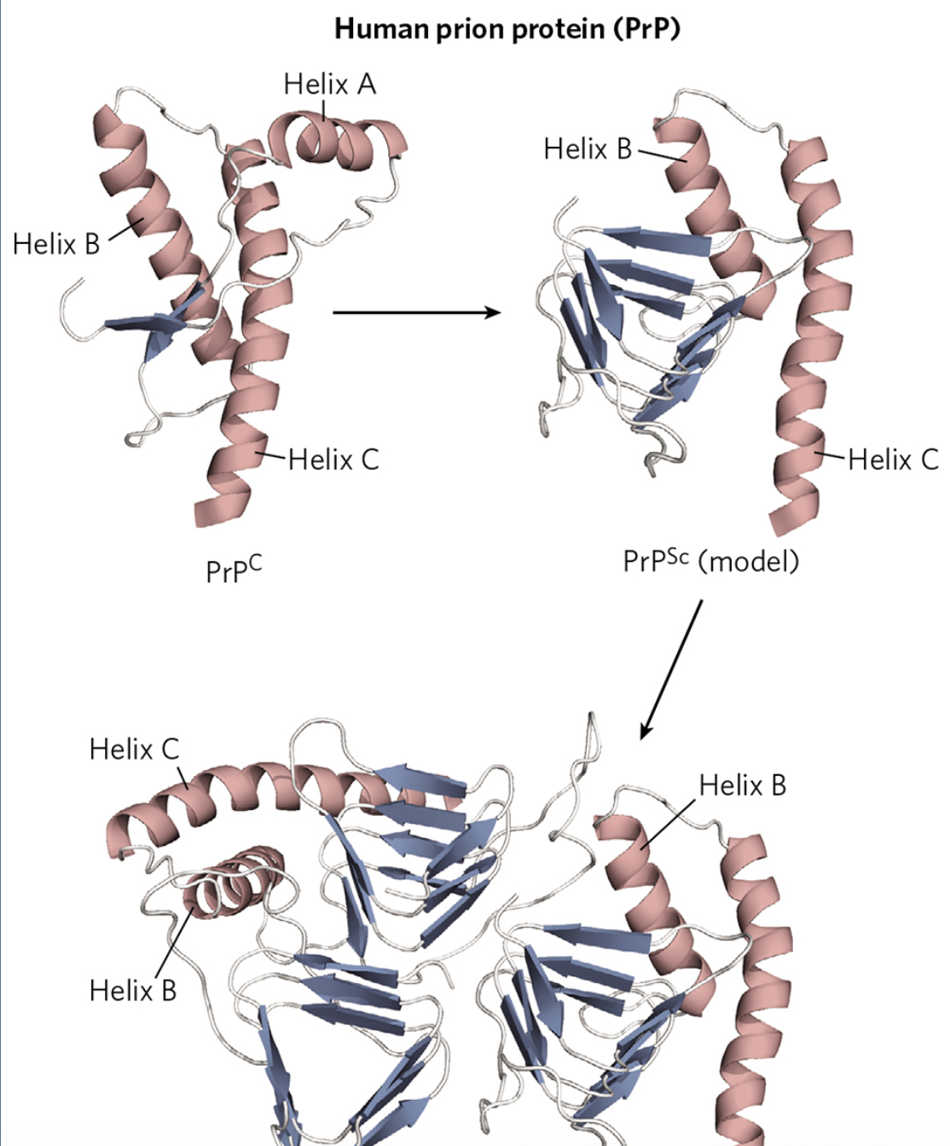
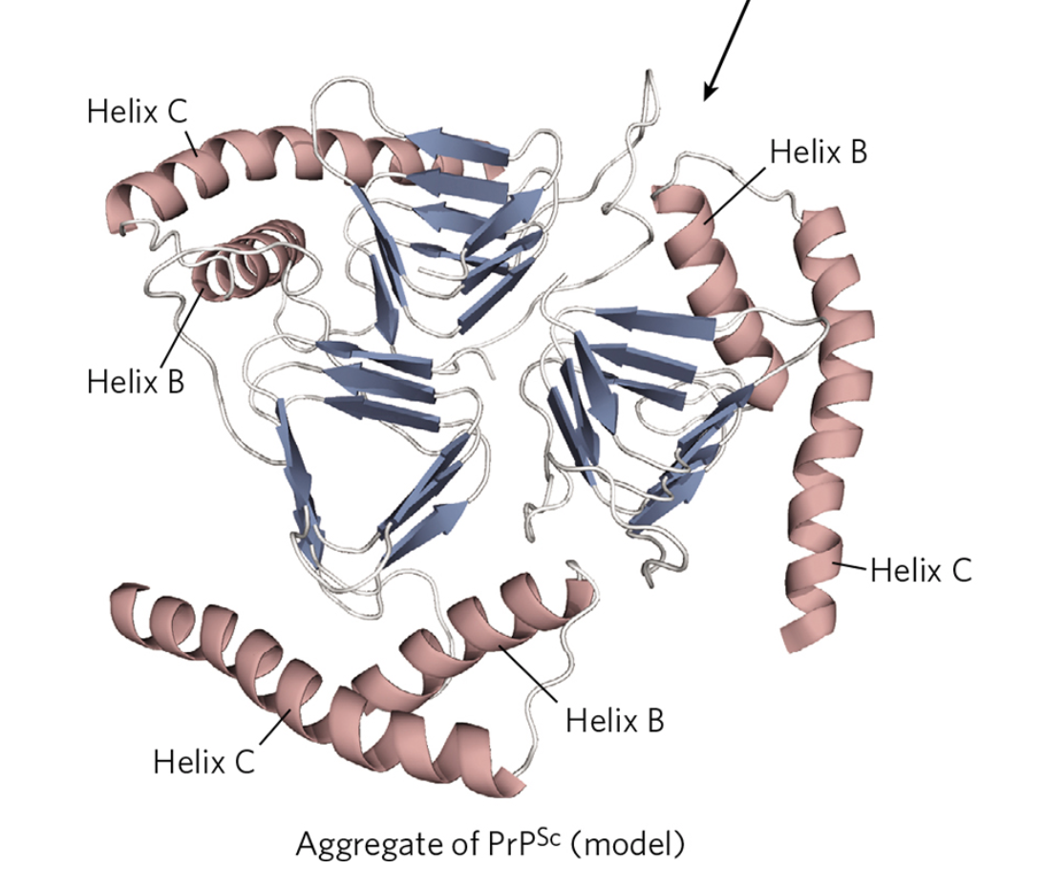
Mad Cow Disease: PrP^{C} →PrP^{Sc}
Bovine spongiform encephalopathy
Kuru, Creutzfeldt-Jakob (human)
Scrapies (sheep)
Chronic wasting disease (deer, elk)
What fundamental principles govern protein stability?

Slide 10
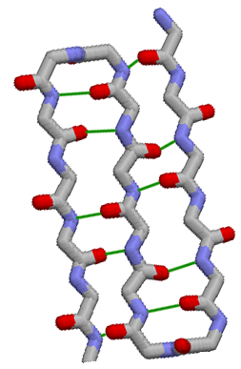
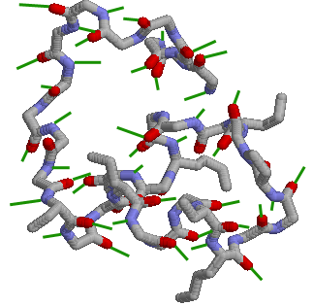
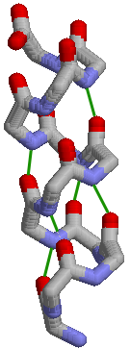
Consider the protein folding/unfolding process
O
H
H
O
O
O
H
H
Measures protein stability
H
H
H
H
O
O
O
H
H
O
H
H
O
O
H
H
O
H
H
H
O
H
H
O
H
O
H
O
H
H
O
H
H
H
H
Fold
H
H
O
H
O
O
H
H
H
H
H
Into 3 β strands + short helix
H
H
H
O
H
O
Unfold
H
H
O
O
H
H
into unstructured, changing strand
O
O
H
H
O
O
H
H
H
H
H
H
H
H
H
H
O
O
O
O
H
H
H
Like considering
a chemical reaction
H
H
O
H
H
H
O
Unfolded protein in water
Folded protein in water
H
H
O
Structure rapidly changing
H
H
O
Structure relatively fixed
O
H
H
H
H

Slide 11
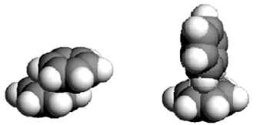
Folded or unfolded, ~ all H-bonds are made
O
Ionic attractions, H-bonds, other weak interactions similar whether protein is folded or unfolded
H
H
O
O
H
H
O
H
H
H
H
Ring stacking
only in folded
protein
O
O
O
O
H
H
O
O
O
H
H
H
H
H
H
O
O
H
H
H
H
H
H
O
O
O
H
H
H
H
O
H
H
H
H
H
H
O
O
O
Fold
H
H
H
H
H
H
H
H
O
H
H
O
Unfold
O
H
H
O
O
H
H
O
O
H
H
H
Key concepts: ΔS_{FOLDING} IS + ΔS_{FOLDING} IS - ΔH_{FOLDING} IS ~ 0
O
H
H
H
H
WATER
H
H
H
O
O
PROTEIN
O
H
H
H
O
TOTAL
H
H
H
H
H
O
H
H
H-bonds within protein
O
~ slightly more # H-bonds in water
H
H
O
O
H
H
H-bonds to water
H
H

Slide 12
Big Picture:
ΔG
Unfolded protein in water
Folded protein in water
ΔG_{Folding} = ΔH_{Folding} - TΔS_{Folding}
Favoring folding:
ΔS is +
ΔH is -
ΔG is -
Key concepts: ΔS_{FOLDING} IS + ΔS_{FOLDING} IS - ΔH_{FOLDING} IS ~0
WATER
PROTEIN
TOTAL
EXAMPLE:
U
F
ΔG_{Folding} favorable (maybe?)
values depend on specific protein!!!
Protein conformational entropy
− TΔS_{Folding}
Water entropy
− TΔS_{Folding}
favorable!
Gibbs Free Energy
unfavorable!
Protein and Water ΔH_{Folding} ~unfavorable (maybe?)

Slide 13
Protein stability: Thermodynamic view reveals driving forces
ΔG
Under physiological conditions, native protein structure is stable
Key concepts: ΔS_{FOLDING} IS + ΔS_{FOLDING} IS - ΔH_{FOLDING} IS -
Unfolded protein in water
Folded protein in water
What does “stable” really mean?!
WATER
G = H - TS
PROTEIN
Energy in all covalent bonds
Gibbs function: Lower G (more negative) means more stable
All electrostatics
Measures # ways to have a given energy
TOTAL
Favoring folding:
ΔS is +
ΔH is -
ΔG is -
Steric overlap (“strain”)
All weak interactions: H-bonds, dipole-dipole, transient dipole
Entropy of protein itself is very unfavorable when protein folds
What about a protein folding in water?
G - G = ΔG
= H - H - T S - S
Must keep track of both protein and water!
Entropy of water more favorable when protein folds
When prot. folded
When prot. unfolded
of prot. folding
When prot. folded
When prot. unfolded
When prot. folded
When prot. unfolded
ΔG_{Folding} = ΔH_{Folding} - TΔS_{Folding}
For overall folding rxn in water:
EXAMPLE:
Very approximately, per 100 AA at 37C:
T
Protein
ΔS_{Folding} = An unfavorable ~ -500 kJ/mol;
Net TΔS_{Folding} +200kJ/mol (favorable)
TΔS_{Folding} is a favorable ~ +700 kJ/mol;
Water
ΔH_{Folding} of combined protein + water interactions is unfavorable (i.e. positive) by 150 kJ/mol
Net protein stability ≡ ΔG_{Folding} = ~ - 50 kJ/moL
Hydrophobic interaction is largest type of favorable interaction that drives proteins to fold in water

Slide 14
Summary:
ΔG
Unfolded protein in water
Folded protein in water
ΔG_{Folding} = ΔH_{Folding} - TΔS_{Folding}
OUR EXAMPLE:
U
F
ΔG ~ − 50 kJ/mol
Protein conformational entropy
− TΔS ~ 500 kJ/mol
Gibbs Free Energy
(TΔS ~ − 500 kJ/mol, unfavorable!)
Water entropy
− TΔS ~ − 700 kJ/mol
(TΔS ~ + 700 kJ/mol)
favorable!
Protein and Water ΔH ~ + 150 kJ/mol,
unfavorable!
[see Case Study: Observation Over Intuition]

Slide 15


How to describe protein stability with a graph?
Lower, or more negative on Gº axis means more stable (Gº is standard state Gibbs free energy)
Why plot Gº rather than G?!
Because pressure = 1 atmosphere and we want concentration to be fixed (G depends on concentration, G° is for standard state 1M).
Simple example: Poly(Glu) sidechain can be CH₂-CH₂-COOH or CH₂-CH₂-COO-
pKa ~ 4
COO⁻
pH < pKa of ~ 4 ∴ H⁺ "mainly on"
COO⁻
COO⁻
pH > pKa of ~ 4 ∴ H⁺ "mainly off"
so uncharged
COO⁻
pH 3
COO⁻
pH 7
so charged!
U
COO⁻
o
o
G
Unfolded
G
Unfolded
Unfolded
Unfolded
No helix stability
helix
x
x
Structural coordinates of this helix
Structural coordinates of helix
Meaning of structural coordinates axis: Positions close on axis are similar in structure; positions far apart are very different in structure.
Note: structural coordinates scale is arbitrary! Here we let “x” represent α-helix on struct. coord axis
This is simple case of α-helix. Now consider entire protein structure….

Slide 16
Protein stability on a graph: denaturation and renaturation
Jargon: Denature is to modify such that natural properties are lost
Renature is to recover natural properties
ΔG^{O}
Protein in physiological buffer
Protein_{Native} Protein_{Denatured}
kJ/mol
(Per residue)
~ 0.3
Unfolded
Unfolded
o
NaCl Na + 1/2Cl₂
G
380
CH₃-CH₃ 2C + 3H₂
50 - 100 kJ/mol protein, or approx. 0.3 kJ/mol residue
33
NH₃ 1/2N₂ + 3/2H₂ 16
N marks the "native structure"
Compared with other familiar molecules, proteins are not very stable
N
Structural coordinates
O
Much H-bonding of urea with water (reversibly) destroys normal water structure, eliminates hydrophobic effect
Denature protein in 8M urea
NH₂-C-NH₂
=
o
G
Lots of different structures, far from native, are comparably stable
No stability of native structure
Remove urea, find protein folding is reversible
N
Structural coordinates

Slide 17
What is the meaning of "reversible"?
Oh no! Multiple meanings in biochemistry!
"Reversible binding" means:
e.g. Hb + O₂ HbO₂
1. Forward and reverse reactions occur multiple times during the observation
2. Appreciable concentrations of both reactants and products are present at equilibrium, i.e. the reaction does not go extremely far to the left or right
3. Not covalent binding
4. Remove additive Return to original state
5. And still one more meaning:
Kinase
e.g. Protein + ATP Protein-PO₄ + ADP
"Reversible phosphorylation" means:
There is covalent binding, but:
This protein can be phosphorylated or dephosphorylated multiple times. The protein can thereby cycle between active and inactive.

